Slide 1
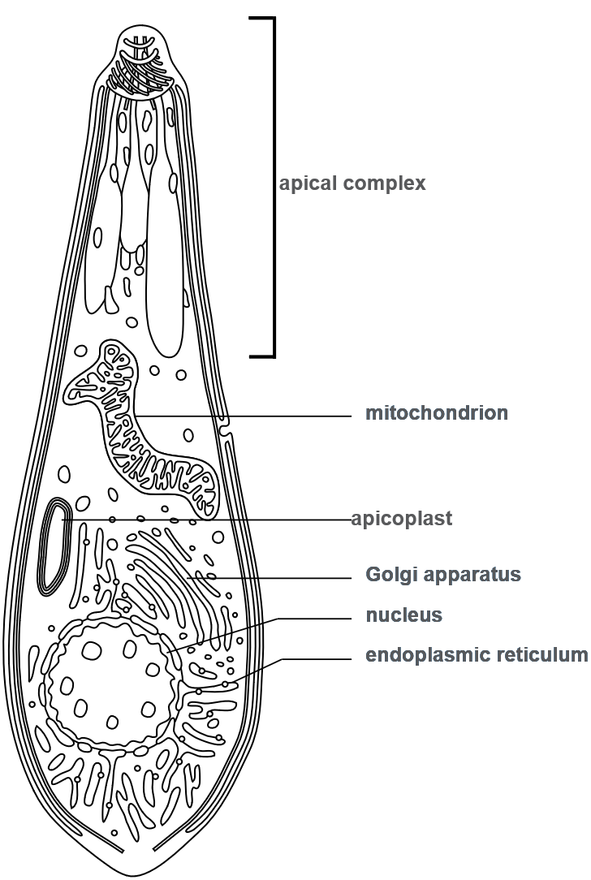
“Apis” are a lineage of parasites and symbiotonts to many animals. Though they need a host, they share ancestry with free-living photosynthetic algae.
Plasmodium falciparum (which causes malaria) and Toxoplasma gondii (which causes Toxoplasmosis) are both Apicomplexa that can infect people.
Toxoplasma can cause changes in the behavior of the mice they infect, making them less fearful of cats.
Apicomplexa
Dactylosoma kermiti, an apicomplexan that infects frogs was named after Kermit the Frog!
This structure allows these parasites to enter their hosts
This structure is a chloroplast which has lost its function of photosynthesis. The ancestor of all Apicomplexa gained its apicoplast from a Red Algae

Slide 2
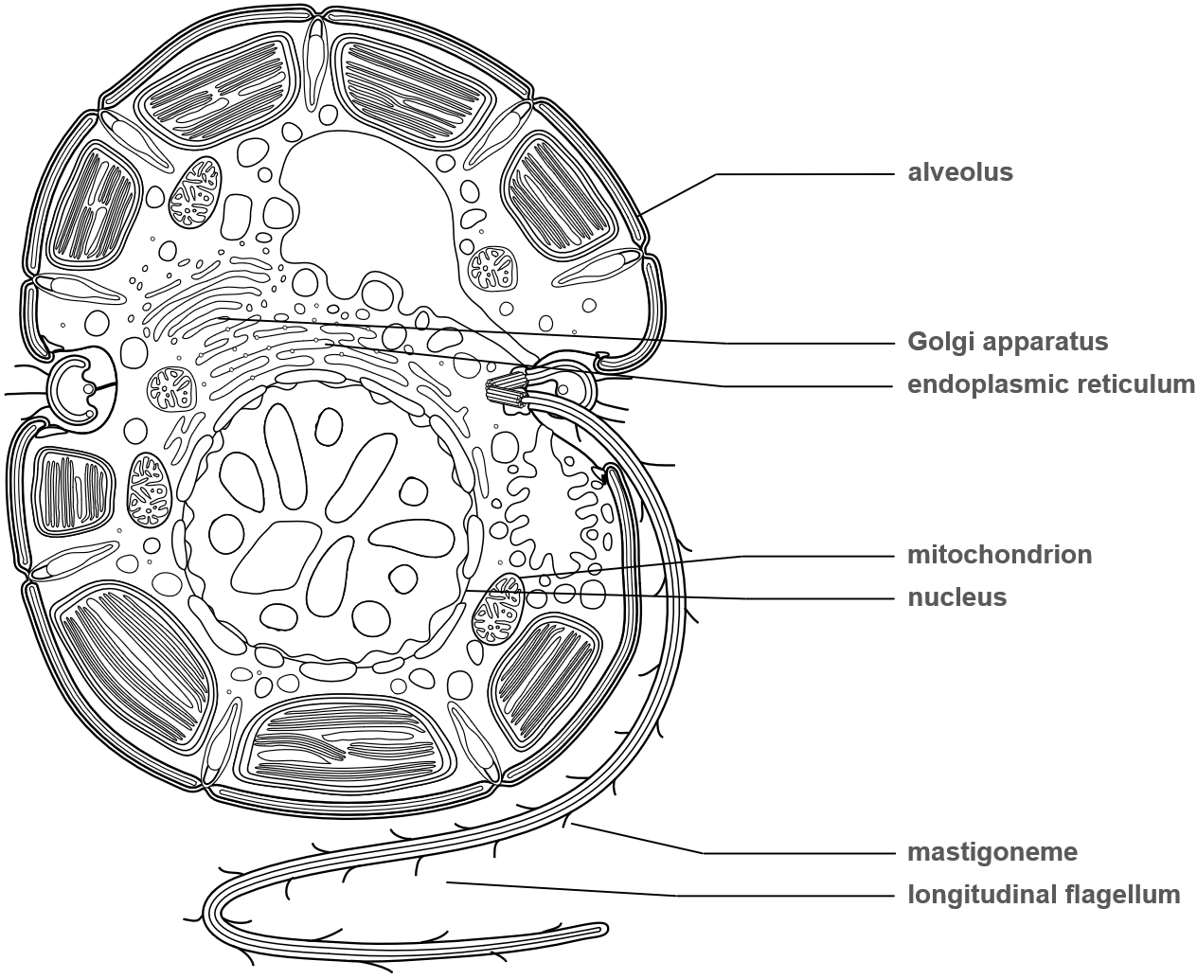
“Dinos” live in marine and freshwater environments. Some are mixotrophic (photosynthetic AND capture prey), and some are completely non-photosynthetic. The photosynthetic taxa are important phytoplankton which produce oxygen.
Dinoflagellate
Some species are bioluminescent and can be seen at night glowing in water, even here in Vancouver!
Some other species are toxic and can cause red tide when there is an algal bloom. And some dinoflagellates are parasitic to other organisms.
Zooxanthellae are dinoflagellate photosynthetic symbionts found in corals.

Slide 3
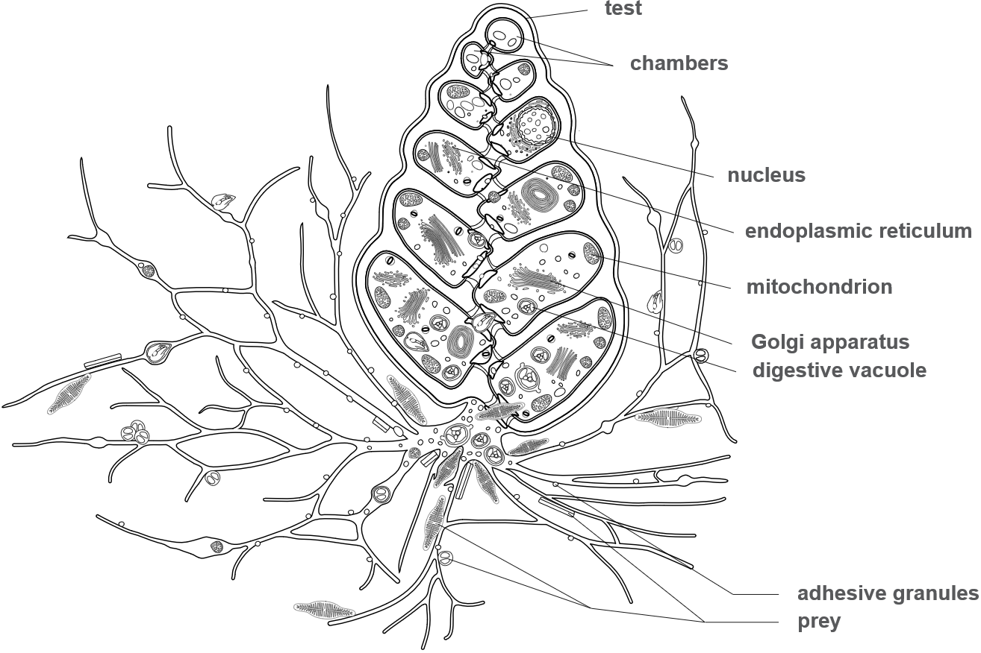
Foraminiferan
"Forams“ are amoeboid predators of the ocean!
Baclogypsina sphaerulata is the species that make star sand (star-shaped exoskeletons which can be seen with the naked eye!)
Xenophyophorea is a clade of large, multinucleated foraminifera that look like sea sponges, but are actually one massive cell!
Tests are microscopic shells that can be made of a variety of materials based on the species. Some are secreted calcium carbonate, organic material, or can be agglutinated sand.
Forams use their long, sticky pseudopodia to capture prey.

Slide 4
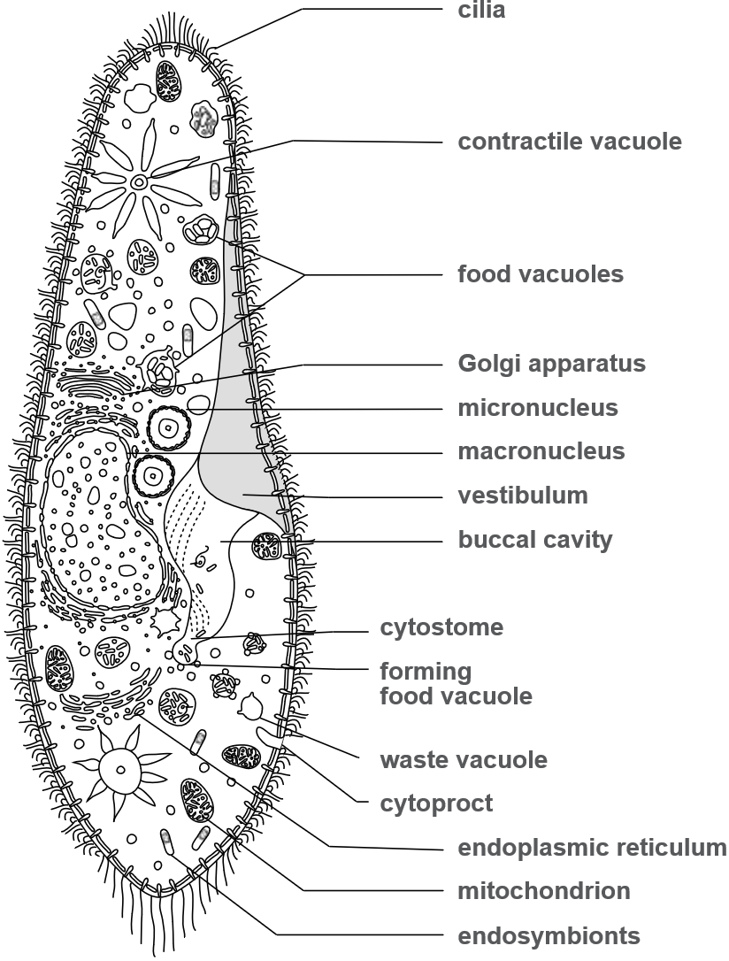
Ciliate
Ciliates are predators of the microbial world and exhibit feeding behavior
Some cells are large enough to see with the naked eye!
Ciliates have two types of nuclei (the macronucleus and micronucleus)
Ciliates eat their prey through their mouth-like cytostome and eject their waste through their anal pore (cytoproct)

Slide 5
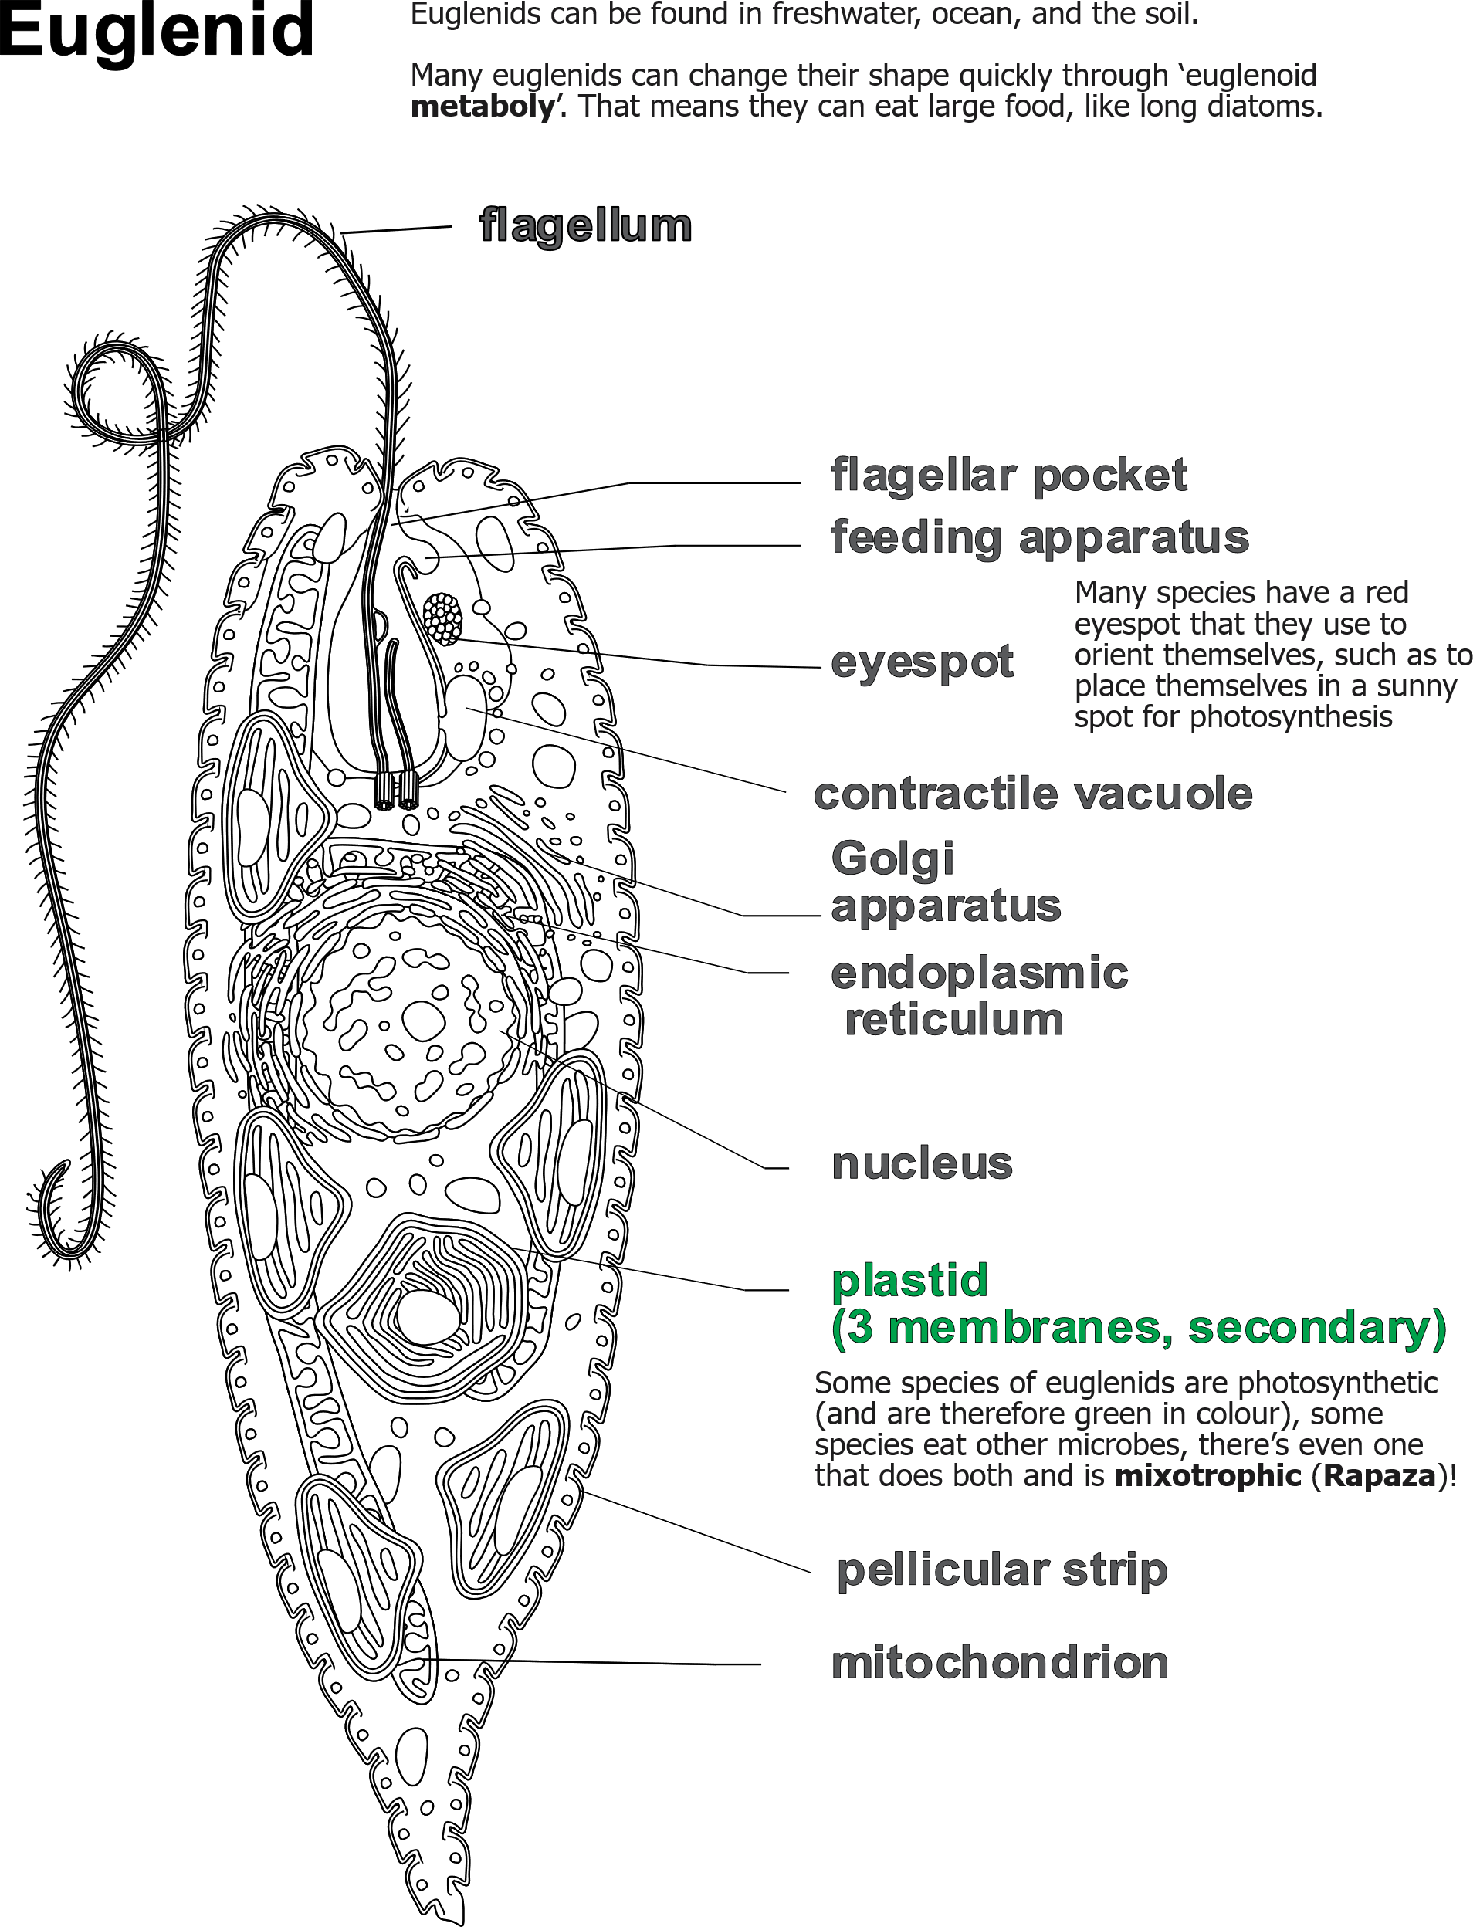

Slide 6
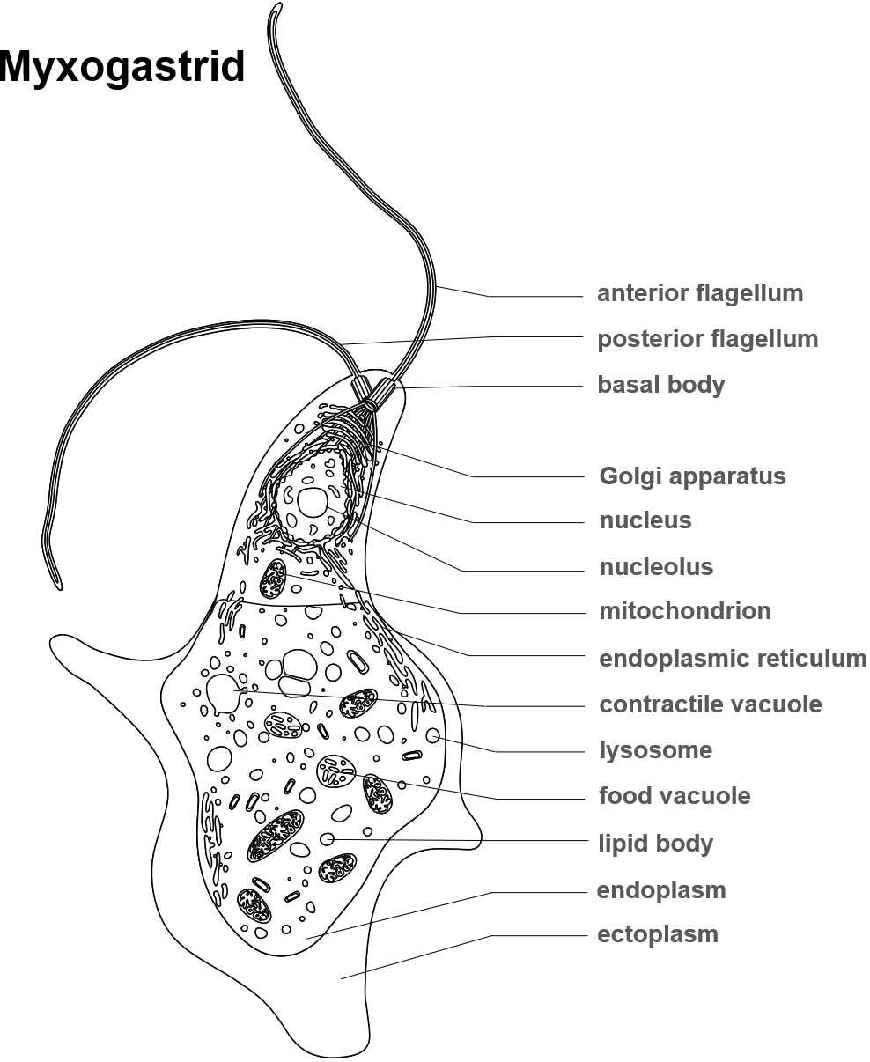
True slime molds (Myxogastria) are a type of social amoeba that have a unicellular life stage (shown), a multi-nucleated “plasmodial” life stage, and a multicellular stage where millions of individuals will come together to form fruiting bodies.
Myxogastrids are considered “amoeboflagellates”, moving using both flagella and amoeboid movement.

Slide 7
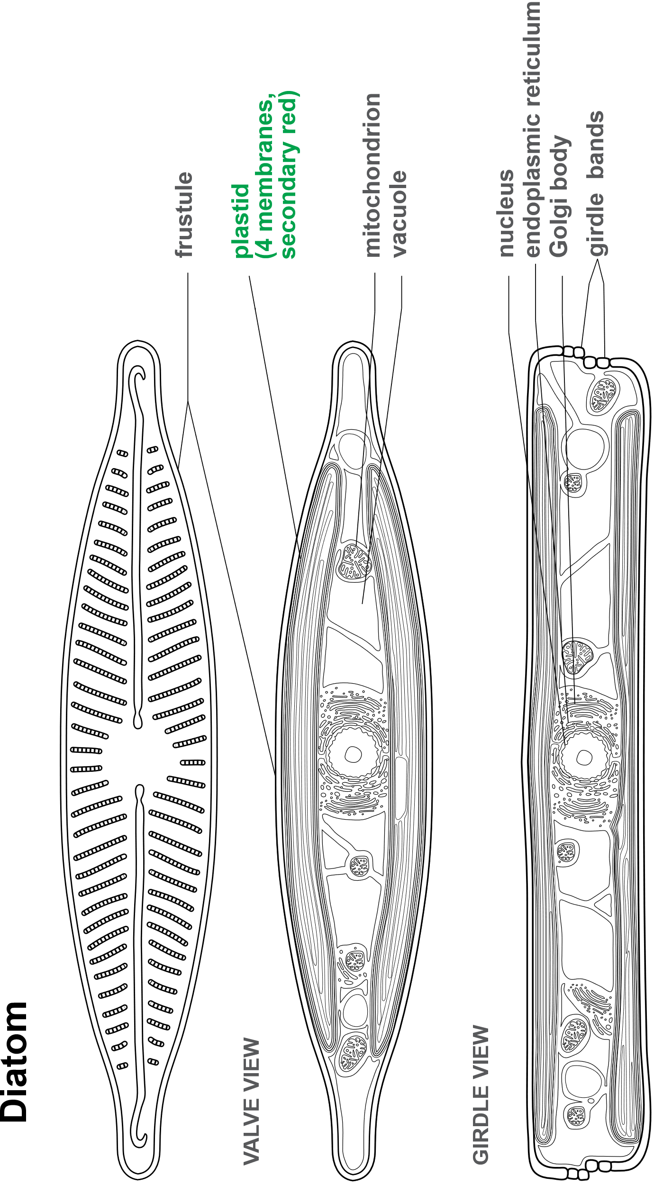
Diatoms are photosynthetic algae that have silica (glass) shells called frustules. These organisms are very common in marine and freshwater environments.
Diatoms come in a variety of shapes, sizes, and colors. Some people make art with Diatom frustules making complex mosaics.
Diatomaceous earth is made from diatom frustules and used for pest control without chemicals.

Slide 8
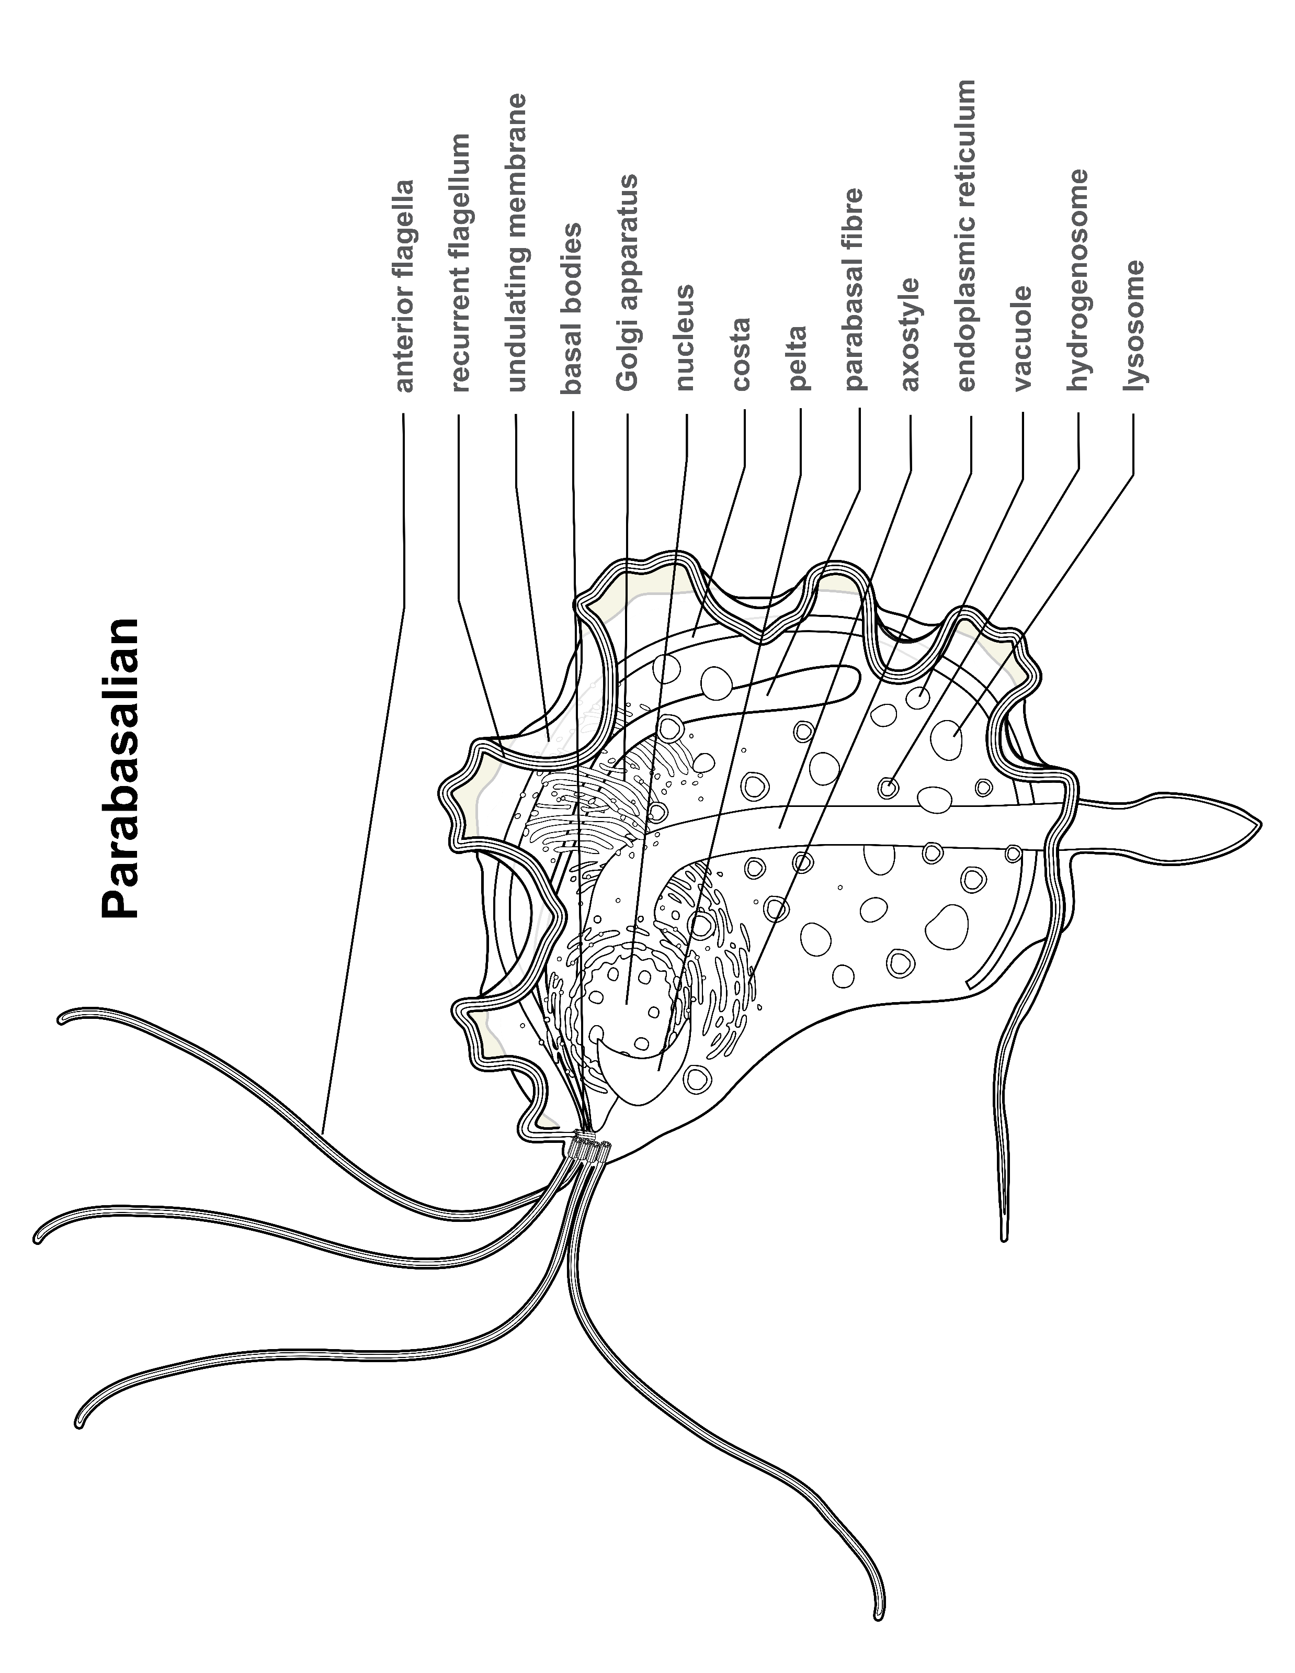
Parabasalia live in anerobic environments. Their mitochondria have evolved into hydrogenosomes which generate ATP anaerobically (without oxygen)
Termites have parabasalian symbionts in their digestive tract to help with the digestion of wood.

